Slide 1


AstroSage
Analysis
TARUN KUMAR ANAND

Slide 2

Problem statement
AstroSage has received a 1 crore investment and aims to optimize its call center operations. The goal is to determine how to allocate this investment to maximize operational efficiency, customer satisfaction, and profitability. The analysis will consider historical call data, performance metrics, and market trends to make informed decisions.

Slide 3

About Astrosage
Trusted online astrology platform designed to provide clarity and confidence in life’s journey.
Dedicated to making astrology accessible to everyone with meaningful insights into life, relationships, and career.
Offers direct connections with experienced astrologers via live chat, call, or video consultations.
Provides a variety of personalized services, including horoscope readings, Vedic astrology, and numerology.
Focuses on delivering tailored guidance to meet the unique needs of every individual.

Slide 4
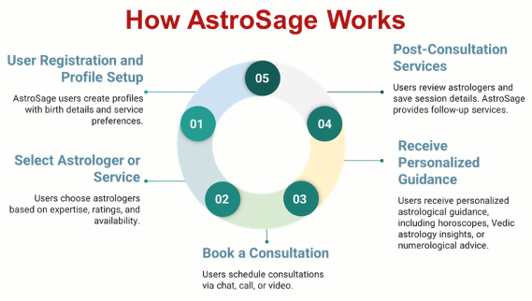

Slide 5

Data Overview
Key Performance Indicators (KPIs)
Engagement: Over 26K monthly users.
Agents: 131 dedicated agents.
Revenue: Monthly revenue over 2 lakhs.
Investment: 1 crore investment for business optimization.
Data Cleaning and Preprocessing
Attribute Removal: Removed non-informative columns.
Data Consistency: Standardized guruName formatting.
Data Cleaning: Removed unwanted characters and handled missing values optimization.
Data Utilization
Business Analysis: Deep dive into AstroSage's business model.
Key Insights: Understand user behavior, internal challenges, and areas for improvement.
Investment Guidance: Identify strategic areas for resource allocation.

Slide 6
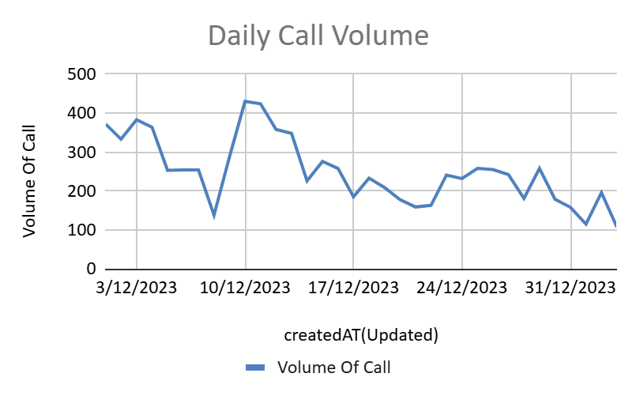
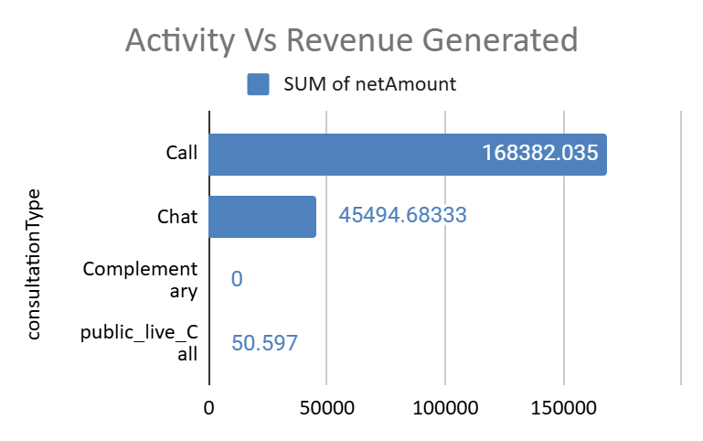
Daily Call Analysis
Observed Trend: A consistent decline in daily call volumes has been identified.
Revenue Impact: Calls represent a significant source of revenue, making this trend a critical issue.
Immediate Action Required: Swift intervention is necessary to mitigate the potential negative impact on business performance.
Root Cause Investigation: Conduct a detailed analysis to uncover the factors contributing to the decline in call volumes.
Short-Term Measures: Implement compelling offers or incentives to drive immediate demand and stabilize call activity.
Strategic Solution: Address the root causes to enable sustainable growth and optimize resource allocation over the long term.

Slide 7
Average Call Handled Per Agent Per Day
Average Calls/Agent: 1.81/day, indicating low activity.
Potential Issue: Suggests low user base or traffic.
Compounding Problem: Declining call volume highlights business risks.
Urgent Action: Sustained decline poses critical challenges.
Temporary Solution: Boost marketing and offer incentives.

Slide 8
Chat/Call Revenue Analysis
Activity: Higher chat activity (19,514) compared to calls (8,505).
Revenue: Lower chat revenue (₹45,495) compared to calls (₹168,382).
Gap: Chat popularity doesn't translate to revenue.
Suggestion: Enhance the chat interface with instant horoscopes, follow-ups, and real-time document sharing to improve user satisfaction and retention.

Slide 9
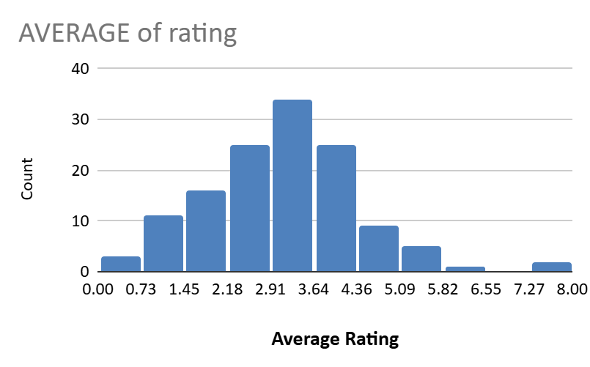
Average Rating Analysis
Indicator: Average user rating reflects user experience and likelihood of revisits.
Interpretation: Higher ratings indicate positive experiences. Lower ratings suggest negative ones.
Concern: Majority of ratings (below 3.64/8) indicate subpar user experiences.
Potential Issue: Agent-provided resolutions may be contributing to dissatisfaction.

Slide 10
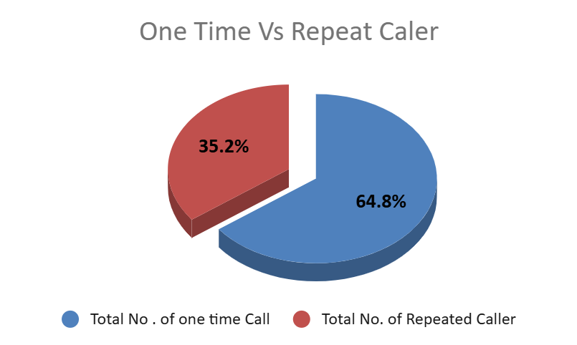
User Engagement Analysis
Key Insights:
One-Time Users: 35.2% of total user base.
Repeat Users: 64.8% of total user base.
Recommendations:
Improve First-Time User Experience: Enhance onboarding and post-service follow-up.
Implement Loyalty Programs: Offer incentives for repeat users.

Slide 11
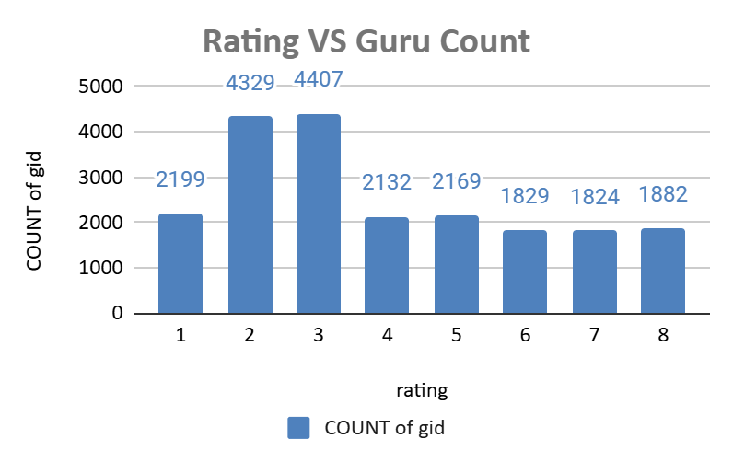
Ratings v/s Guru count analysis
Key Insights:
Majority of gurus are rated 2-4, peak at 3 (4,407 gurus).
Fewer gurus in ratings 5-8, indicating improvement potential.
Few gurus achieve top ratings.
Recommendations:
Provide training for gurus with ratings 2-4 to improve interactions.
Introduce performance-based incentives for higher ratings.

Slide 12
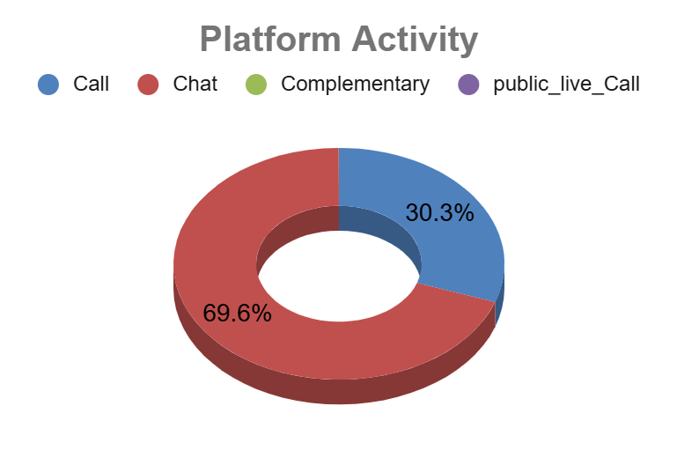
Platform Activity Overview
Key Insights:
Chat Dominance: Chats account for 70% of activity
Call Revenue: Calls generate higher revenue despite lower activity.
Recommendations:
Focus on monetization: Optimize agent performance and conversion tactics to increase revenue per chat session.

Slide 13
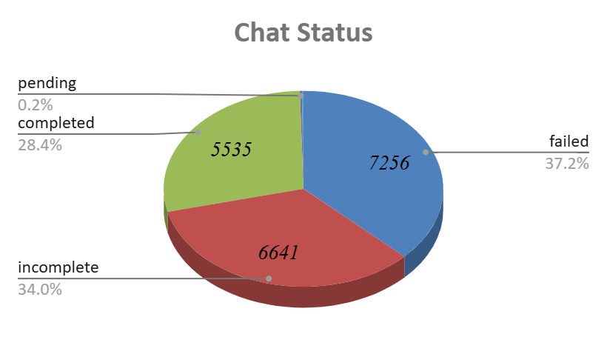
Chat Status Analysis
Key Insights:
High Failure & Incomplete Rates: Over 13,897 chats not resolved.
Opportunities for Improvement: Address reasons behind incomplete and failed chats.
Recommendations:
Improve Support Processes: Upgrade systems, train staff, reduce response times.
Implement Chat Automation: Use AI-powered chatbots for simpler queries.

Slide 14
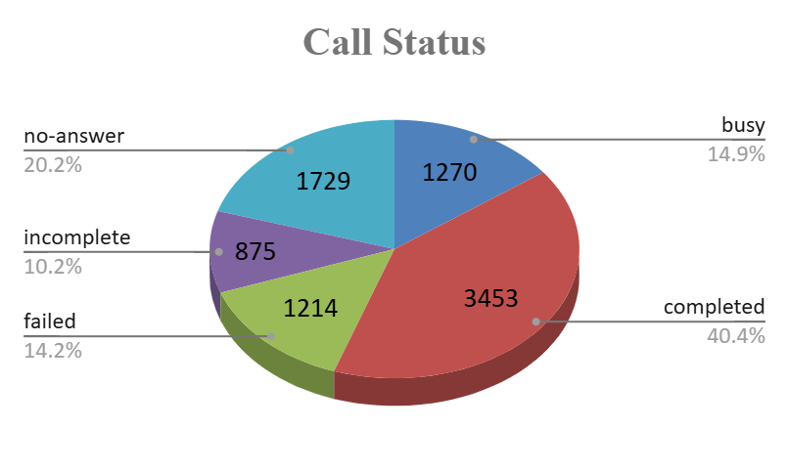
Call Status Analysis
Key Insights:
Success Rate: Only 40.4% of calls are successfully completed.
Improvement Areas: Address issues with "No Answer," "Busy," and "Failed" calls.
Recommendations:
Optimize Timing: Implement automated callbacks.
Enhance Queue Management: Expand agent availability or improve call routing.
Upgrade Systems: Strengthen infrastructure and provide advanced agent training.

Slide 15
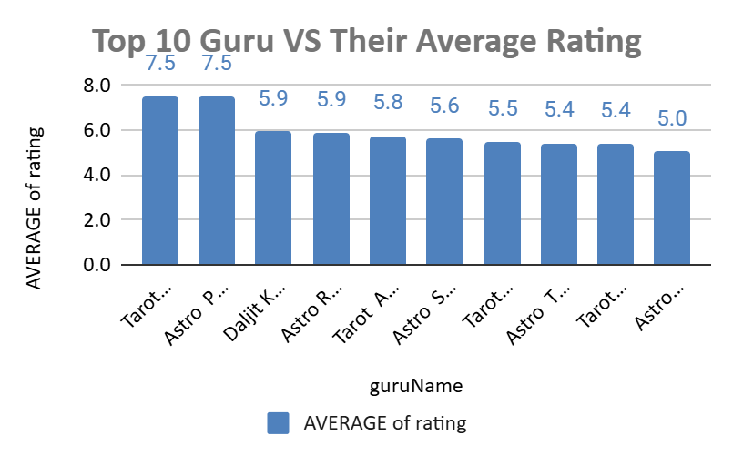
Top Performing Gurus
Key Findings:
Top Performers: Tarot Mystical. and Astro Pujaa.
Insights:
High Ratings: Top gurus have significantly higher ratings..
Recommendations:
Targeted Training: Focus on lower-rated gurus.
Customer Feedback: Encourage feedback for mid-tier gurus.
Best Practices Sharing: Create mentorship program

Slide 16
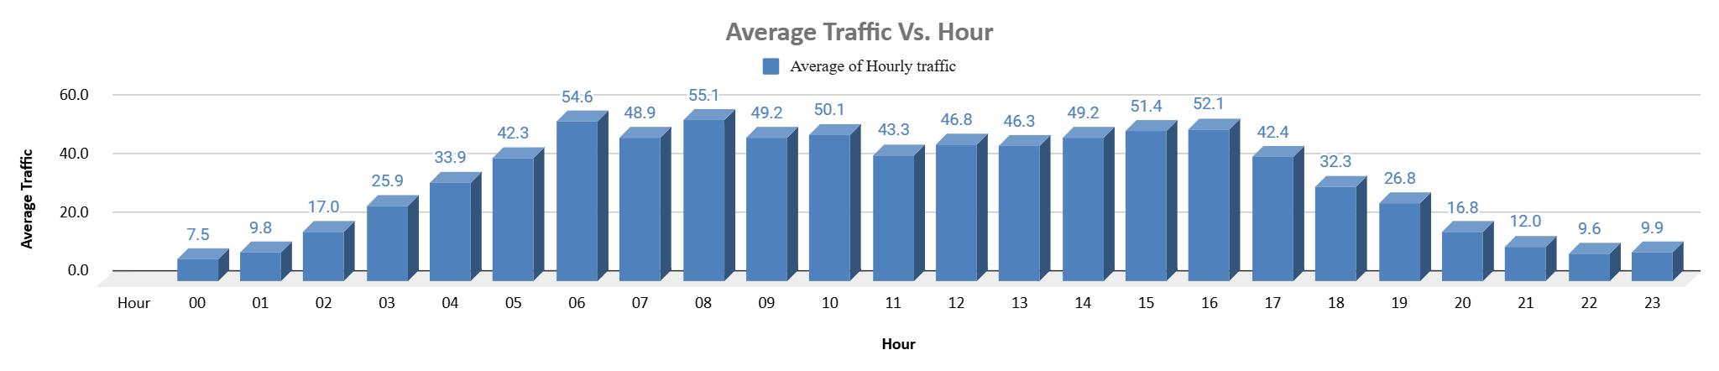
Average Traffic Distribution Analysis
Peak Hours: Daily traffic peaks between 6 AM and 4 PM.
Business Importance: This time period is crucial for the business.
Skill Requirement: Highly skilled professionals needed for optimal customer satisfaction.
Solution: Flexible staffing and shift optimization for efficient workload distribution.

Slide 17

Strategic Recommendations
Recommendation: Implement advanced call tech, use predictive algorithms for traffic.
Reason: Imbalanced call handling, agent burnout, and inconsistent service.
Expected Impact: Improved efficiency, faster responses, better customer satisfaction.

Slide 18

Enhancing Customer Interactions Through Targeted Training
Recommendation:
Invest in targeted training programs.
Incorporate real-time feedback tools.
Reason:
Analysis shows high chat activity but low revenue.
Expected Impact:
Higher revenue through improved conversions.
Increased customer loyalty through personalized and empathetic interactions.

Slide 19
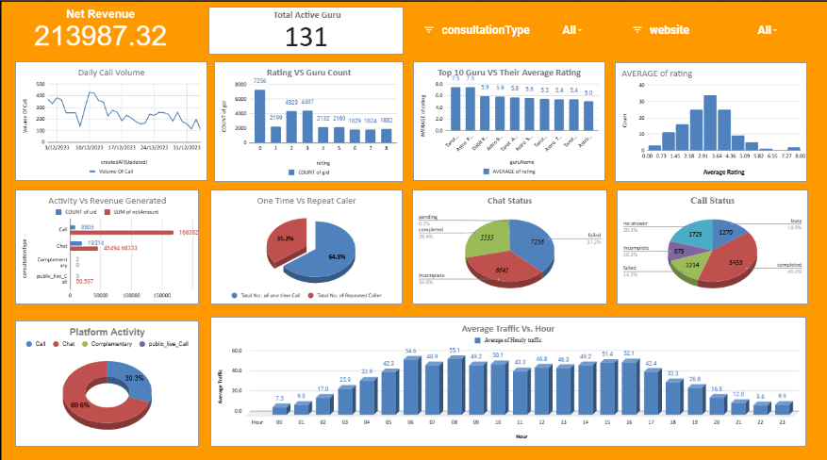
Analytical Dashboard

Slide 20

Optimizing Customer Service Technology
Recommendation:
Upgrade call center tech for real-time solutions.
Use AI chatbots for initial triaging.
Optimize CRM tools for better query management.
Reason:
Chat activity-revenue gap is significant.
Expected Impact:
Boost market share via scalable services.
Improve customer experience with faster resolutions.

Slide 21
Conclusion
Key Findings:
High chat activity, low revenue.
Uneven workload distribution.
Training gaps.
Implications:
Operational Efficiency: Optimize technology and balance workload.
Revenue Growth: Improve agent training and upgrade technology.
Customer Satisfaction: Invest in technology and training.
Closing Statement: Implementing these recommendations will improve AstroSage's efficiency, customer satisfaction, and market competitiveness.

